Slide 1
Physically-aware Laser Fault Injection Assessment
Henian Li, Sukanta Dey, Farimah Farahmandi ECE Department, University of Florida
All rights reserved

Slide 2
Outline
Backgrounds of fault-injection attacks
Post-silicon verification on laser fault-injections (LFI)
Pre-silicon modeling effort on LFI
Motivations
Proposed LFI assessment framework
Laser cell library development
Experimental results
Conclusion
Notes:
3
Fault-injection attack (FIA) is a major category of physical attacks, it compromises the integrity, confidentiality, and availability of modern SoCs. To mitigate the threats from fault injections, researchers have been proposing modeling and verification approaches in both layout level and post-silicon stage of IC design.
In this paper, we focus on pre-silicon laser fault injection modeling and assessment.
We first talk about some backgrounds about different categories of fault-injection attacks, then for the laser fault-injection, we will introduce different modeling and verification methods at both post-silicon and pre-silicon stage. We then summarize their limitations and the motivations of our work.
In our work, we propose a pre-silicon assessment framework to verify the layout’s resiliency against laser. Our proposed framework can inject Gaussian laser current profiles of any spot size into the physical layout. To make it scalable, we perform SPICE simulations, and apply machine learning approaches to develop cell-level laser fault models which can capture the current characteristics of every standard cell, under different laser-induced transient current intensities. This laser cell library is then utilized during laser fault simulation. Finally, we demonstrate effectiveness of the proposed framework by analyzing the fully implemented AES design layout.

Slide 3
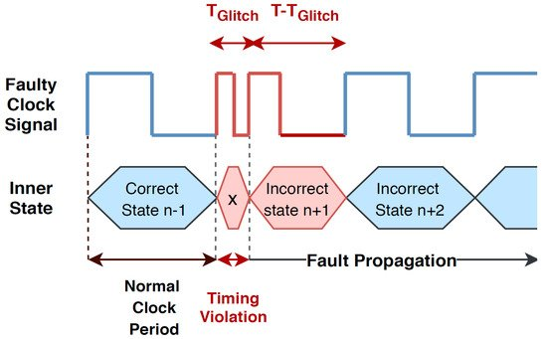
Rise of Fault Injection Attacks
Fault Injection Attacks
Errors are intentionally injected in a system to compromise the security of the design and facilitate the leakage of assets in the system.
Taxonomy of Fault Injection Attacks:
Non-Invasive Attack
E.g., clock glitching, power glitching
Semi-Invasive Attack
E.g., focused light beam (laser), overheating by light
Invasive Attack
E.g., focused ion beam (FIB)
Source: Kazemi Z, Hely D, Fazeli M, Beroulle V. A Review on Evaluation and Configuration of Fault Injection Attack Instruments to Design Attack Resistant MCU-Based IoT Applications. Electronics. 2020; 9(7):1153.
3
Notes:
Fault-injection attack is defined as the attacker trying to compromise the system’s security by intentionally injecting errors. Nowadays, it has become a major concern for hardware designs, because of their powerful capability causing a threat to the security assets in modern SoCs.
Fault-injection attack has three categories: non-invasive, semi-invasive and invasive attacks. Today we focus on a powerful semi-invasive attack: laser fault-injection.
3

Slide 4
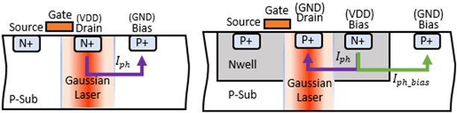
Laser Fault Injection (LFI)
Infrared laser is used to affect a smaller area. (wavelength: 760 nm - 1100 nm, typically from backside of the active region)
Laser creates electron-hole pairs at the drain of a NMOS and thus creates a current pulse.
Current pulses of all impacted cell add up and create IR drop & ground bounce.
Short time to avoid damage.
(1) NMOS under laser
(2) PMOS under laser
4
Notes:
The laser beam used by fault-injection is typically an infrared laser to affect a small area, trying to induce faults very locally on a single cell or a very limited amount of cells. The laser can be focused from either front-side or back-side of the chip. Nowadays, with the flip-chip packaging becomes more widely applied, the threats from back-side laser fault-injections have become more severe.
From either side, when the laser beam passes through the silicon substrate, it generates electron-hole pairs (EHPs), which under reverse-biased PN junction drift apart to create photoelectric current. These currents can cause charging/discharging of capacitive load at the gate’s output to cause single event transient (SET) or flip the value in memory element to cause single event upset (SEU).
Due to the shrinkage of the technology node, the laser will impact a bunch of cells instead of a single one, therefore the laser can also cause significant impact on the IR drop, which leads to voltage drop and ground bounce on power grid. Take an inverter for illustration, let’s say the input is ‘0’, if we consider the laser illuminated on the drain of NMOS, laser-induced current will flow from drain to Psub- bias. However, when the laser impacted PMOS, since Nwell and Psub are reverse biased in normal operating conditions, transient current (Iph bias) also flows from Nwell bias to Psub bias, and this small shortage current will add up based on all impacted cells.
4

Slide 5
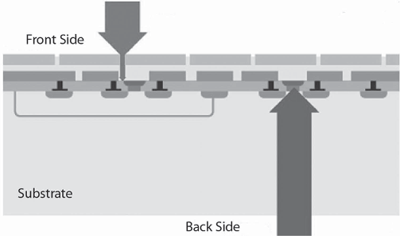
Laser Fault Injection (LFI)
LFI is one of the most powerful fault-injection categories
Local transient-fault injection
Each cell / range is influenced independently.
Thus, good stability and control of timing and location.
Low complexity if attacking from backside
Protective metal layers of the front-side block the incident photons.
However, the substrate of widely adopted flip-chips is vulnerable in backside.
(1) Illustration of front side and back side laser illumination
5
Notes:
So from the mechanism and effects of laser fault-injection, we can see why it is a big threat:
1. It is injecting faults locally, which means each cell or range is influenced independently. This creates good stability and control of timing and location of laser fault-injection.
2. It has low complexity if attacking from backside. In modern chips, the protective metal layers of the front-side can block the incident photons for most areas. However, the substrate of widely adopted flip-chips is vulnerable from backside. In practice, many back-side laser fault-injections only require removing the metal lid, slightly silicon polishing or even none of these (the bare die is accessible).
5

Slide 6
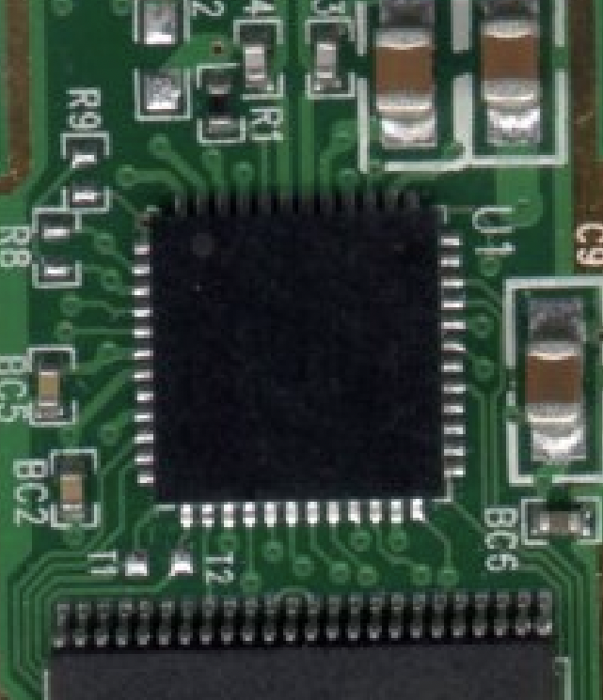
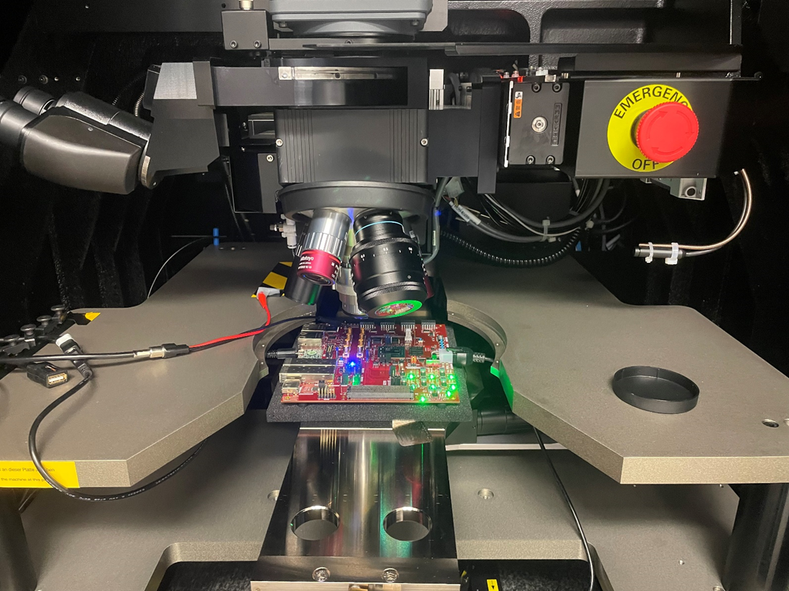
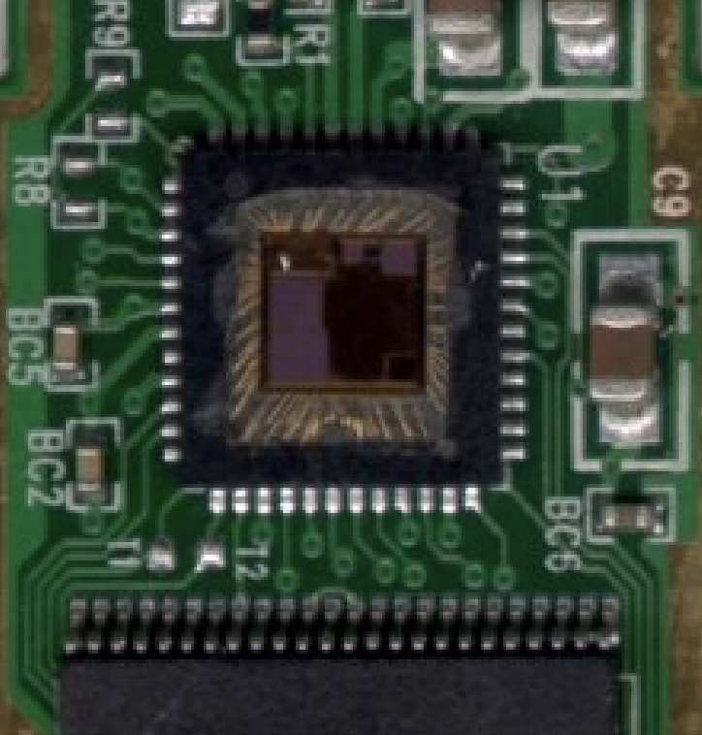
Post-Silicon LFI Verification Steps
De-package
Thinning
Laser Illumination
Monitor output
Challenges:
De-packaging and thinning are tedious.
Improper surface can cause laser scattering.
Can lead to false negatives – False sense of security.
(1) Chip depackaged while on board
(2) Phemos-1000 with 1060nm laser
Source: Moundi, P. L. (2019). Cost effective techniques for chip delayering and in-situ depackaging. Cryptology ePrint Archive.
6
Notes:
At post-silicon stage, there are already some laser verification approaches applied in the areas of fault analysis, defect detection, etc. Such approaches often intend to do a thorough test applying laser beams on the chips after de-packaging and thinning.
However, these approaches have some challenges: First, the de-packaging and thinning are tedious, and they need to be carefully done to avoid damage to the chip. Second, an improper surface after polishing may cause laser scattering and lead to false observations about whether the security rules are violated.
Also, from the standpoint of avoiding the security issues, it is impractical to start over the design and make modifications is security issues are found by post-silicon approaches.

Slide 7
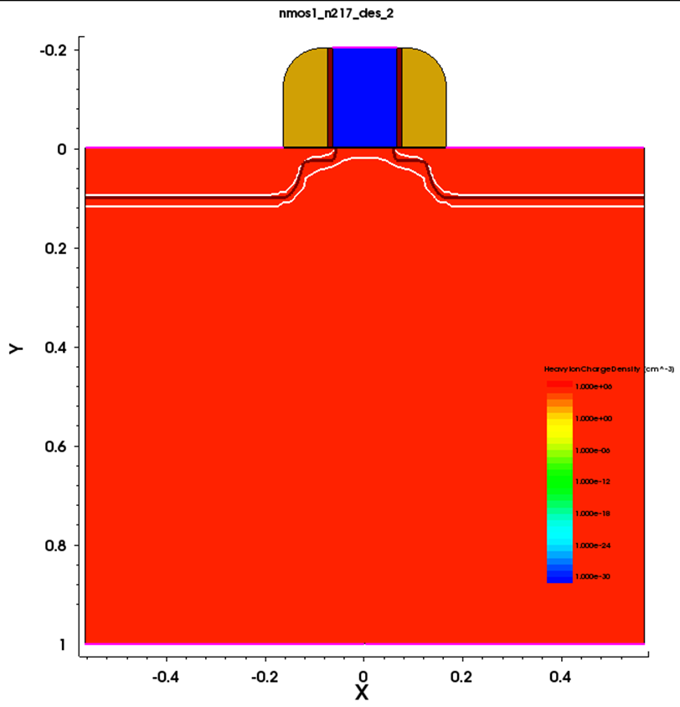
Pre-Silicon LFI Modeling Efforts
Logical fault simulation
Injecting fault during RTL/netlist simulation
Fast but cannot include physical information
Electrical fault models
The laser's impact is modelled as current sources
Not scalable for large designs.
Device-based (TCAD) fault models
Use heavy ions to model the laser impact.
Not scalable.
(1) Laser modeled as heavy ion on 32nm NMOS.
7
Notes:
Pre-silicon LFI modeling can be done at several design abstractions: logical, electrical, and device-level to investigate the impact of laser on digital circuits.
1. Logical fault simulation relies on injecting fault during RTL/netlist simulation, thus is fast but cannot account for any physical characteristics of the laser (laser intensity, spot size, wavelength, etc.) nor the layout (power distribution network, metal widths, routing, etc.).
2. For electrical models, the laser's impact is modeled as a photocurrent (using the current source) induced at the reverse-biased PN junctions during SPICE simulations.
3. In contrast, device-based (TCAD) models use heavy ions to model the laser impact during device simulation.
Though both electrical and device models can account for the physical characteristics of the laser during modeling, they are not scalable to large designs due to modeling and simulation complexity.

Slide 8
Limitations of Existing LFI Verification / Modeling Methods
Post-silicon scenario:
Pre-silicon scenario:
Huge fixed and recurring Cost
Equipment and maintenance
A diverse set of laser / optical sources for different test scenarios
Time complexity
De-packaging, substrate-polishing, etc. are time-consuming
Uneven surface can cause laser scattering
Difficult and expensive to get repeated process & results
Design and countermeasure complexity
Need to start over the chip design if vulnerable to LFI / OFI
Modeling the laser effect on individual cells
Only single fault models can be adopted.
Reduced technology node
A single laser can impact multiple cells.
Multi-laser fault scenario can happen.
Thus, it is challenging to analyze the impact on the overall IP or SoC.
8
Notes:
From here we can summarize the limitations of existing laser verification or modeling methods.
For post-silicon scenario:
1. It has huge fixed and recurring cost, which includes the equipment and maintenance. Also, from security perspective, different attackers with different approaches need to be considered. Thus, a diverse set of laser / optical sources for different test scenarios is necessary.
2. As mentioned, de-packaging, substrate-polishing to ensure a proper surface without damaging the functionality are time-consuming. It would be more difficult and expensive to get repeated process and results.
3. Need to start over the chip design if vulnerable to laser fault-injection, which brings design and countermeasure complexity
For pre-silicon laser modeling:
Current approaches using SPICE model or TCAD model are focusing on individual cells, it is impractical to apply these modeling on the full layout.
Also, due the reduced technology node, a single laser can impact multiple cells and those faults at different locations can propagate, therefore, the multi-laser fault scenario should be considered.

Slide 9
Motivation
There is need for a tool that can allow laser verification on the entire chip
Consideration of physical characteristics
Consider cell's spatial position, neighbor cells, power distribution network, switching activity, etc.
Can be used to evaluate countermeasures, which is difficult at post-silicon
Flexibility in design changes
Rapid assessment for different designs
Exploit combination of logical and layout simulations
9
Notes:
Therefore, a scalable pre-silicon LFI assessment framework that combines different modeling abstractions is needed to allow fast LFI assessment of layout designs.
To achieve this, such tool must have two capabilities:
1. Consideration of physical characteristics: The tool should consider cell's spatial position, neighbor cells, power distribution network, switching activity, etc. It can also be used to evaluate countermeasures that may require multiple design changes and fine adjustments, which is difficult to do so at post-silicon.
2. Flexibility in design changes: the tool should be scalable between different attack scenarios and designs. Since such requirements are time-consuming to achieve at layout-level, it is necessary to exploit the combinations of logical and layout simulation results.

Slide 10
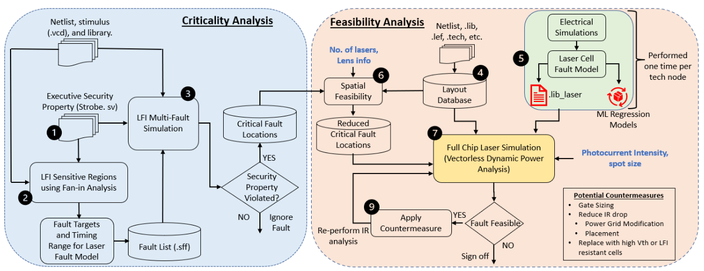
Proposed Laser Fault Injection Assessment
10
Notes:
In our work, we have successfully integrated a pre-silicon LFI assessment framework into a commercial sign-off tool to allow verification engineers to analyze the impact of laser stimulation on the chip. The laser fault locations and their feasibility to inject can be obtained after performing laser fault simulations using our tool.
Overall flow for our fast and scalable pre-silicon LFI assessment:
Criticality Analysis: security property driven assessment using logical fault simulations at the gate-level netlist to identify the critical locations (gates/flip-flops) in the layout. This step identifies those locations violating the security rules from logic and greatly narrow down the focus of performing laser simulations.
Feasibility Analysis: SPICE simulations and machine learning to develop cell-level laser fault models under different laser-induced transient current intensities. This laser cell library is used during full-chip LFI feasibility analysis for the cells inside laser illumination.

Slide 11
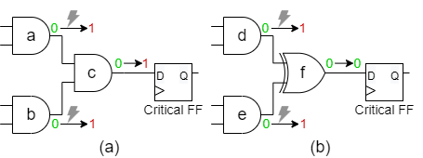
Criticality Analysis
Uses logical fault simulations to identify the locations critical for laser fault injection.
Critical Fault Locations
Multi-fault logic Simulation
Property Violated ?
LFI Sensitive Locations
Security Properties
Critical Registers
YES
Example security property:
The 1st column of AES K9 should not be faulty at the 29th cycle of execution.
(1) Effect of multi faults during laser illumination
11
Notes:
For the criticality analysis step, we performed fault simulation at gate-level using Synopsys ZOIX to identify the locations critical for laser fault injection.
It is a procedure driven by security properties. First, we define the executable security properties that explicitly state the time and locations that cannot be violated. For example, many Differential Fault-Analysis attacks on AES focus on the intermediate states or the round keys at 9th to 10th round to retrieve the secret key. Thus, to protect the design against such attack, e.g., for two highly cited DFA papers, we can define this security property: The 1st column of AES 9th round key should not be faulty at the 29th cycle of execution.
Next, we perform the fan-in analysis for the given attack window to identify other gates/flops from where faults can propagate to the critical registers involved in security properties. The identified fan-in cells contribute to generating a fault list for the fault simulation. Each fault in the list could be single-location, or multi-location, considering that a single laser spot can inject multiple faults. Further, the fault is modeled as a transient fault and simulated. The fault simulator performs security property-checking, when comparing the good and faulty simulations. Any fault causing security property violations is labeled as critical locations.
Figure (1) explains why such multi-fault simulations are necessary by giving two opposite cases. In Fig. 1(a), laser source impacted both gate a and b’s outputs to be flipped simultaneously, causing gate c's value to be flipped, thus violating the security property by impacting the critical flip- flop. Note that independent faults at gates a or b cannot violate the critical flip-flop alone. Fig. 1(b) illustrates the contrasting example when the multi-faults cause the fault masking. In this case, gate f is an XOR gate, which enables any single-fault injected on either gate d or e to propagate and violate the security property. However, if both gates d and e are flipped simultaneously by laser, it keeps the original value safe in the critical flip-flop. Due to reduced technology nodes, such cases are more prevalent during laser illumination.

Slide 12
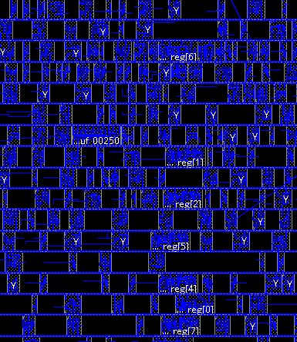
Feasibility Analysis
1. Cells Location Feasibility
Can they be covered within the same laser spot?
For the given multi-fault identified registers
2. Laser Power Feasibility
Once identified that this particular multi-fault scenario is geographically possible.
Model the laser effect and perform full-chip layout simulation.
For the given laser power, is it possible to flip the bit?
Identify the distance of the cell from the spot center.
12
Notes:
With the identified critical locations, feasibility analysis aims to assess whether it is possible to inject laser faults for the given laser specifications and layout parameters.
Multi-fault LFI feasibility is assessed in two steps:
More of a pre-processing step, to solve the question: Given the geographical locations of the fault nodes, is it possible for laser spot to cover nodes simultaneously? After this step, the list of laser-sensitive cells are further reduced since some muti-fault locations cannot be included by one laser spot.
Main question: Given the laser parameters and distance from the spot center, is it enough energy is injected to cause fault? First, we draw an approximate laser spot covering the critical cells’ list. For each cell, we approximate the laser-induced photocurrent. Next, to prepare for full-chip laser simulation, we extract the SPICE model for each standard cell and perform the electrical simulation by adding the laser transient current. Depending on the distance of the cell from the laser spot center, the induced photocurrent should vary. However, this laser-induced current can be impacted by various factors. It is not feasible to calculate the current demand on power pins based on all these arbitrary currents. Therefore, we built machine learning regression models to create a mapping between different photocurrent intensities and the current demand on power pins. Thus, created a laser cell library, which can scale the current up or down for the impacted cells during laser simulations. Finally, for each critical location, we place a laser spot and substitute the impacted cells with those from the laser cell library. The vectorless dynamic power simulation is performed with varying laser photocurrent intensities in our laser cell models, this can capture the demand current and IR drop at the cell instances under laser illumination.

Slide 13
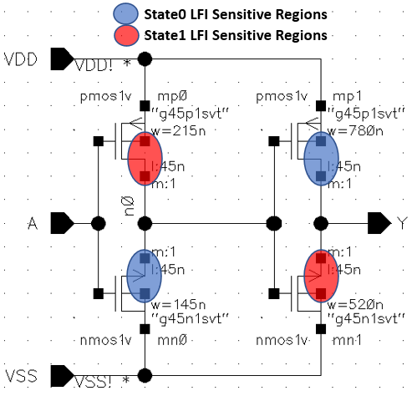
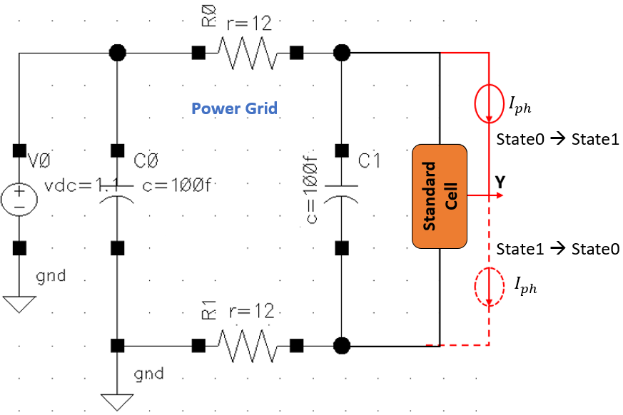
Laser Fault Model
(2) SPICE circuit used to model the net laser current and capture the current demands on power rails
(1) Different laser states and corresponding laser sensitive regions
Notes:
To build laser cell models for each type of the cell, we first perform the cell-level SPICE simulations using Cadence Spectre.
For example, in the case of the buffer shown in Figure (1), when the cell’s output is ‘1’, drain junctions mn0 and mp1 (labeled as blue) will be reverse-biased and experience the laser-induced transient current flowing across them. Similarly, drain junctions mp0 and mn1 (labeled as red) will be reverse-biased during state 0 and most sensitive during laser illumination.
Adding transient laser current at every reverse-biased drain junction is challenging for complex standard cells consisting of many transistors. Therefore, we consider the worst-case scenario, where for the output pin to flip from state1 to state0, the cell should experience the overall flow of transient current from the output pin to the VSS (GND) rail. And similarly, when the cell is in state0, the overall transient current should flow from the VDD rail to the output pin to experience the fault injection. Figure (2) shows the overall SPICE circuit used to simulate different standard cells under laser illumination. This has simplified the simulation of complex standard cells under laser illumination.
For laser library generation, every standard cell is simulated for laser illumination when in State0 and State1, and the currents on VDD and VSS rails are captured for both states. During laser illumination, these currents on power rails are recorded for all the standard cells in the library. They are then packaged together to form the laser library used during the full-chip level simulation.

Slide 14
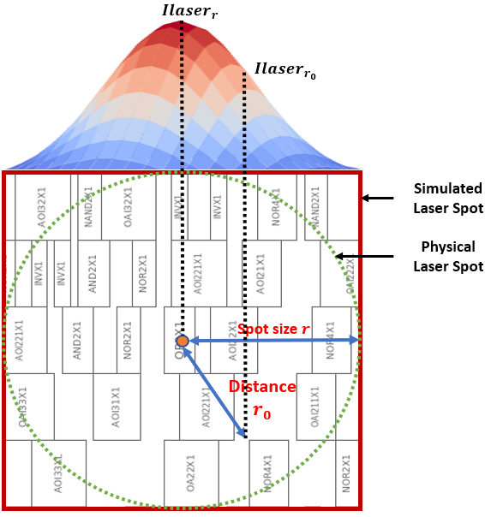
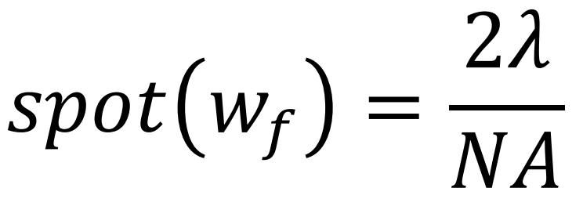
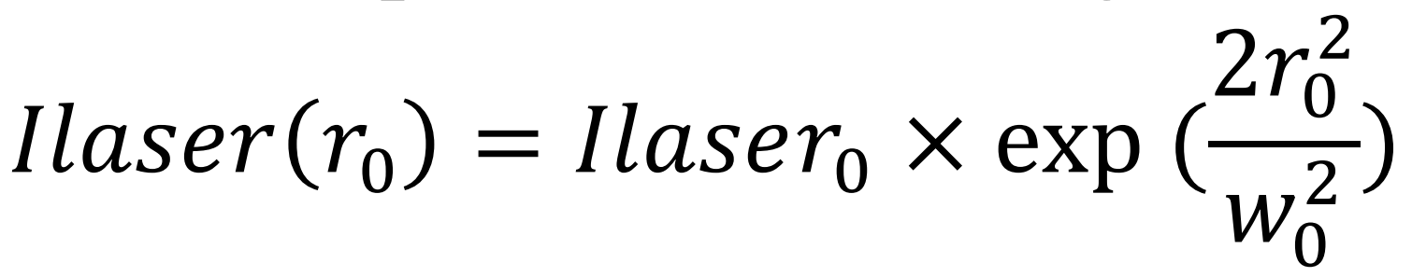
Laser Modeling at Layout
All cells inside laser spot are replaced with cells from the cell-level laser library.
Depending on the distance from the spot center, we scale up or down the current demand on the cell.
This needs to be done only once for all standard cells in the technology library.
Notes:
This figure shows the laser's Gaussian effect modeling in the laser. The dotted green circle shows the laser's physical spot size, where peak intensity reduces to 1/(e^2). The solid red square shows the laser spot considered during layout simulation due to the ease of modeling a square bounding box instead of a circle. For the given laser, which follows a Gaussian distribution and wavelength 𝜆, lens objective with a numerical aperture (NA), the laser's spot size at the objective's focal length can be approximately given as: 2𝜆/NA. The spot size calculation can also be freely changed by users.
The induced laser transient current intensity is maximum at the spot center. The laser's current intensity for the standard cell at a distance 𝑟0 from the spot center can also be calculated as the formula here. All cells inside laser spot are replaced with cells from the cell-level laser library. And depending on the distance from the spot center, we scale up or down the current demand on the cell.
We did the laser cell lib generation for 45nm Cadence library containing approximately 75 cells, and this only needs to be done once for a technology library, and then can be applied to different designs and scenarios.

Slide 15
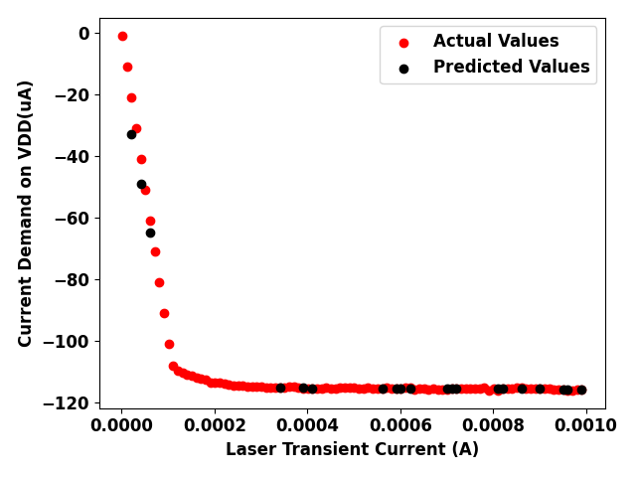

Regression Model
(1) Laser State 0, Cell: INVX1, Pin VDD.
(2) Laser State 1, Cell: INVX1, Pin VDD.
Regression models are to identify the current demand for the given laser transient current.
Due to non-linear relationship, KNN model worked the best with more than 98% accuracy on 80-20 train test split.
Notes:
To build the standard cell laser library for all arbitrary values of photocurrent intensity is not feasible, therefore, we built machine learning regression models to create a mapping between different photocurrent intensities and the current demand on power pins. These ML models, during full-chip laser simulation, scale the current up or down for the impacted cells.
These two figures here show the current demand for INVX1 standard cells on power pins in different laser states, similar results on VSS are also collected but not shown here. The negative sign on the VDD pin signifies the direction of the current. To learn this trend, we applied different non-linear regression models. Due to non-linear relationship, KNN model worked the best with more than 98% accuracy on 80-20 train test split.

Slide 16
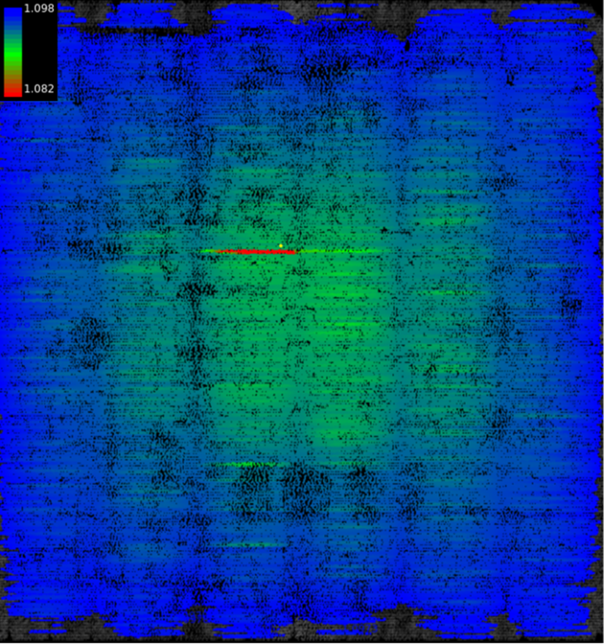
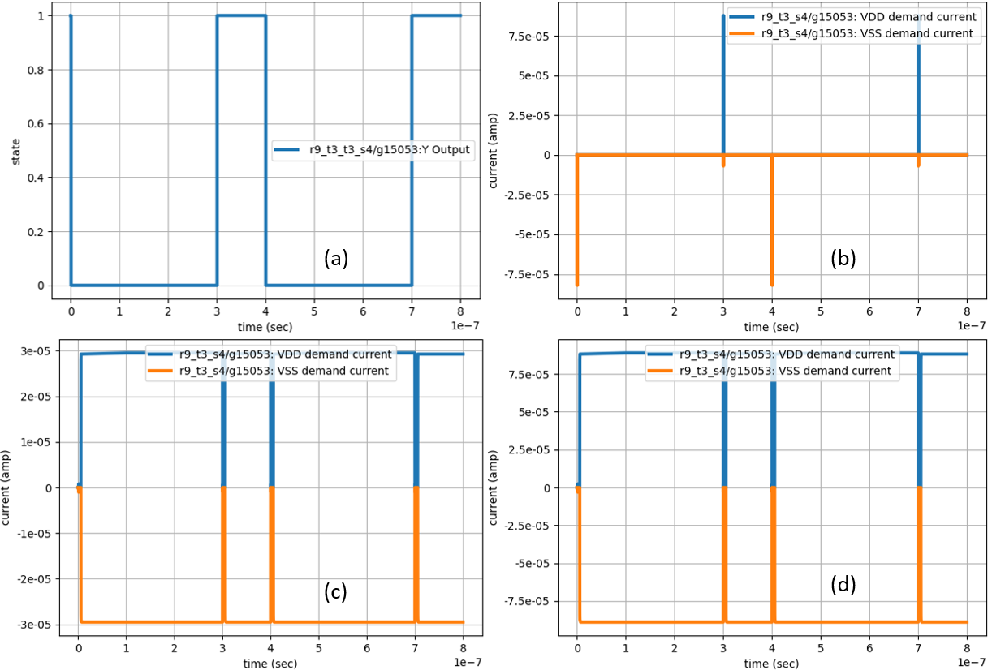
Laser Illumination Result
(2) Current demand on inverter cell for different cases. (a) Output toggle (b) Current demand when no laser (c) Current demand during low power laser (d) Current demand during high power laser.
(1) Laser effect simulated during full-chip layout simulation.
Notes:
For performing the full-chip laser stimulation:
A laser spot is created at the critical location for a given objective lens. For example, for a 50x lens with NA is 0.42, the spot size is ~5𝜇𝑚 for a 1064nm wavelength laser. Then all the cells inside that spot are replaced with laser cells. Then, we perform the vectorless dynamic power simulation using Ansys Redhawk-SC for varying photocurrent intensities and capture the demand current and IR drop at the cell instances under laser illumination.
For the given laser photocurrent intensity, if the cell current demand is greater than the current demand observed during normal cell switching, it means the laser injects fault at that cell. Figure (2) shows the current demand on INVX cell under normal switching, laser but no fault injected, and laser with fault injected. Note that depending on the cell location, i.e., whether it is surrounded by high switching cells, closer to the power distribution network, DECAPs, etc., the photocurrent intensity at which the cell experiences fault can vary. Therefore, a standard cell placed at different chip locations will fail at different photocurrent intensities due to these layout-specific parameters. The results will cover the exhaustive analysis for all the identified critical instances for the security property on the tinyAES benchmark and their dependence on different layout-specific parameters.

Slide 17
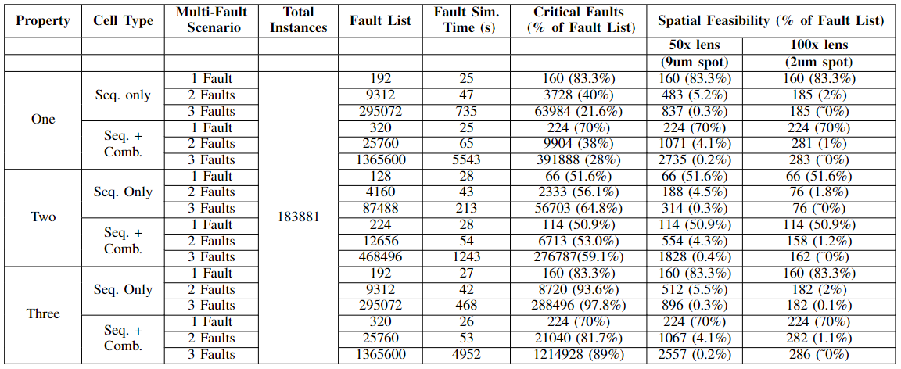
Criticality Analysis Results
Table: Criticality and Spatial Feasibility results for 3 security properties on AES Layout.
17
Notes:
This table concludes the criticality and spatial feasibility results for 3 different security properties against DFA on AES Layout.
For criticality results:
We performed up to 3 concurrent faults scenario for each security property. The “Fault List” column shows the total number of simulated faults, and “Critical Faults” column shows the identified locations from gate-level fault simulations. Note that the number in these two columns does not mean the number of involved instances, but the number of faults. Each of the faults can be involving single-location, or more concurrent locations.
For spatial feasibility results:
When spatial feasibility analysis is applied, only a small portion of critical locations can be included in one laser spot, thus, reduced the LFI assessment target list significantly. Finally, the number of spatially feasible faults for the given laser and lens parameter are very few compared to the total instances in the design. Thus, we need to inject laser at only those fault locations instead of exhaustively illuminating the entire chip.
Another observation is that: from the red rectangulars labeled here, it can be seen that in the 100x lens case, the spatially feasible faults remain the same for three simultaneous fault scenarios due to spot size limitation.

Slide 18
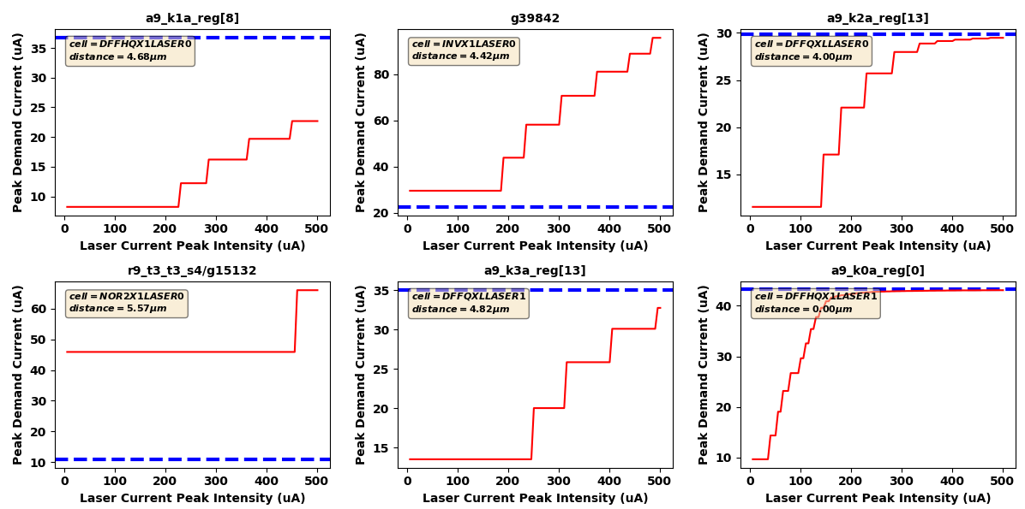
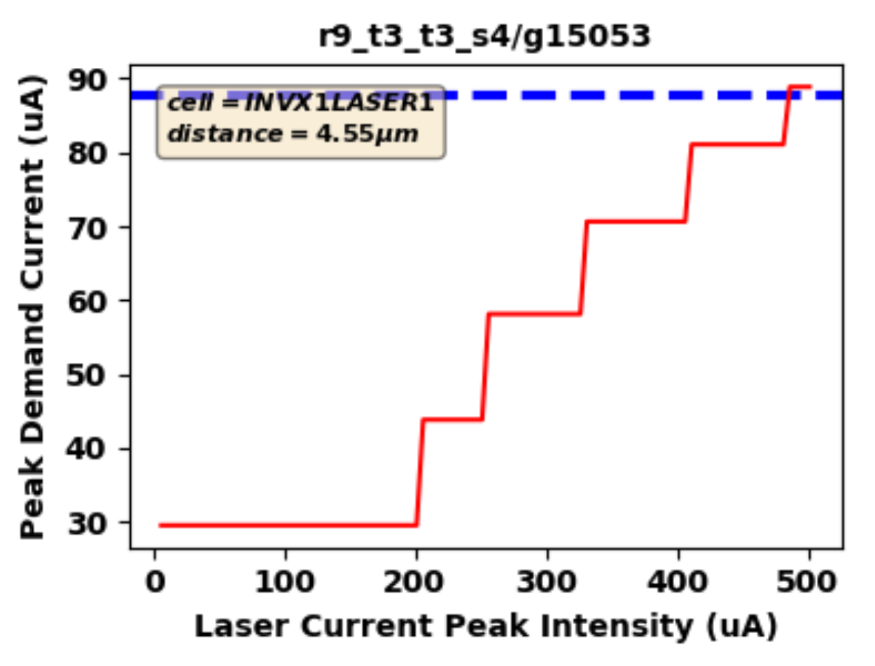
Feasibility Analysis: Demand Current (VDD Peak)
18
Notes:
Now we introduce two usages of our tool to perform laser feasibility analysis and corresponding results.
First, Single-spot experiments:
For each spatially feasible fault (each fault might be either single location or multi-location), we put single spot of laser on that one fault and vary the laser intensities from 0 to 500 uA
In this case, the laser is centered to a9_k0a_reg[0] cell, which is a DFF, shown at the bottom right figure (we can see its distance to center is 0). The laser intensity at other impacted instances is scaled based on their distance to center as we mentioned.
Blue dotted line: original current demand when there is no laser
Red line: laser-induced current demand
If the current demand on the pin goes above the dotted blue line, it can be assumed that the cell has experienced a fault (output flipped) due to the laser. It can be seen that instance a9_k0a_reg[0] fails around 200𝜇𝐴 of laser peak intensity. Another interesting thing to note is that the instances g39842 and r9_t3_t3_s4/g15053 are of the same INVX1 type and are approximately the same distance from the laser center. However, they experience fault at different laser peak intensities. This happens because instance g39842 is surrounded by bulky (like DFF) and high switching cells. Since they draw more current from the power rails, the impact of the laser is amplified on the instance g39842. Whereas instance r9_t3_t3_s4/g15053 has a lot of empty space around it. This observation shows that the placement of standard cells can amplify the effect of laser on critical cells.

Slide 19
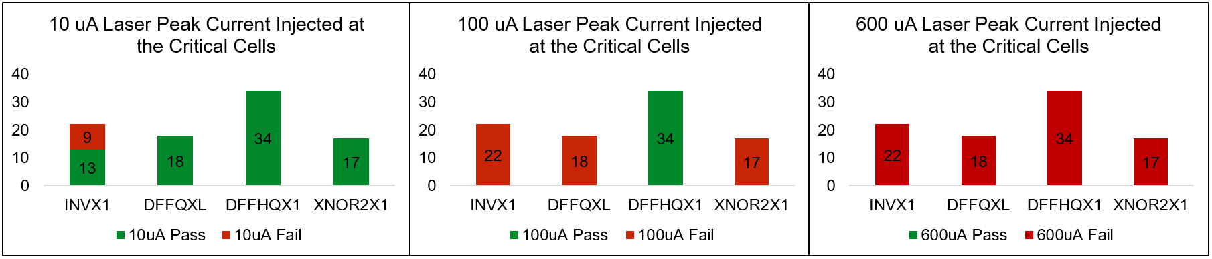
Feasibility Analysis: Multi-Spot
Number of critical cells failing for different laser current intensities
Observations
Cell Size can impact susceptibility.
Surrounding cells and their switching activity can impact the susceptibility.
Distance from PDN can impact the susceptibility.
19
Notes:
Second, Multi-spot experiments:
For one fixed given laser intensity, we test all of the critical cells to see how many can be flipped. We do this because it was seen that nearby cells impacted by laser could also impact the resiliency of the critical cell against laser. From the criticality results, it can be seen that for Property 1, there are 160 critical faults for one fault scenario. Since we inject faults in 28 and 29 clock cycles for Property 1, of these 160 instances, only 91 are unique standard cells on the layout placement. Since we perform vectorless dynamic power simulation to model the laser effect, we consider only these 91 critical instances location to inject fault. In the results figure here, we also separated the cell types of these unique critical instances. For 10 𝜇𝐴 peak intensity laser, only nine instances experienced a fault, and all of them were of INVX1 cell type. It was seen that bulky cells like DFFQXL and DFFHQX1 experienced fault at higher laser peak intensities.
We repeated this experiment for 3 laser intensities, respectively: 10uA, 100uA, 600uA. From the above results, we concluded two observations: 1) Type of nearby cells and their switching activity can impact the critical cell's resiliency against laser injection. 2) Bulky cells require higher laser intensities to inject fault. 3) Distance from PDN can impact the susceptibility.

Slide 20
Conclusions
Existing CAD tools lack full-chip LFI verification capabilities
At post-silicon: high cost, time complexity and design complexity
Pre-silicon LFI modeling: only at cell-level, not scalable to full chip
We proposed a pre-silicon framework in verifying the full-chip layout's resiliency against LFI
Security property-driven criticality analysis at gate-level
Laser cell library built from SPICE simulations and ML models
Enabled precise layout-level design fix for critical cells failing the LFI threshold

Slide 21
?

